Slide 1

Python Review and Tutorial

Slide 2

Intent of Course
Quick review of Python
Problem-centric
Tailor to needs
Please give feedback on what you would like out of the course
Please give suggestions on other topics to cover
Other languages, specific problems, automation, etc

Slide 3
Overview
Review of Basics
Extending Python
The Pythonic Way
Pandas Data Wrangling
PyODBC Data Base Connector
MatPlotLib Visuals
Scikit-Learn Machine Learning
Automating Python Scripts in Windows
Putting It All Together

Slide 4
Review of Basics
Environments
Basic Properties
Variables
Comments
Collections
Conditionals
Loops
Functions

Slide 5

Review of Basics
Environments
IDLE
Included with Python, written in Python
Integrated Development and Learning Environment
Anaconda
Spyder GUI
Iron Python console
IDLE console
Includes many packages
Plugins for Visual Studio
PyCharm
Jupyter
Server based – can run online
Coursera runs this

Slide 6
Review of Basics
Basic Properties of Python
Compiled or Interpreted: Interpreted
Can also be compiled
Typing discipline:
Duck-typed
Dynamic
Declarative or Imperative: Imperative Language
Notes:
Things to keep in the back of your mind for now.
Will help more when we get into other programming languages, like SQL

Slide 7
Review of Basics
Primitive Variables
Define variables by setting the values
Integers
Int_val = 5
Float
Float_val = 2.5
Strings
String_val = “this is a string, brah”
string_val = ‘this is also a string, brah’
Booleans
bool_true_val = True
bool_false_val = False
Notes:
Called float because it is a floating point. Example: output x=32984328947213.21934782391472193874239847293184

Slide 8

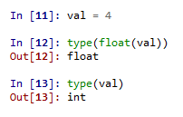
Review of Basics
Variables
Getting the type
type() function
Conversions
type name, followed by value to convert in parenthesis
float(int_val)
str(double_val)
Notes:
Variables store values. Variables let us not worry about memory management. Variables can change.

Slide 9
Review of Basics
Comments
#
Single-line comment
“”” “”” or ‘’’ ‘’’
Designed for documentation sections
Can work as a block-style comment for testing

Slide 10
Review of Basics
Collections
tuple
Tuple is mathematical set of numbers
Set and access elements with ()
Analogous to array, value-type collection
Can mix value data types

Slide 11
Review of Basics
Collections
list
Holds multiple values that can change
Set and access elements with []
Reference-type collection
Can mix value data types

Slide 12
Review of Basics
Collections
dictionary
Hash table, name:value pair
Set with {}
Access elements with []
Very fast at loading values
Further reading: https://stackoverflow.com/questions/327311/how-are-pythons-built-in-dictionaries-implemented

Slide 13

Review of Basics
Class Exercise:
Create a list of at least 5 foods
Create a tuple/an array of constant values (like days in the year, approximate value of pi, etc)
Create a dictionary of state abbreviations and names

Slide 14

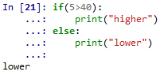
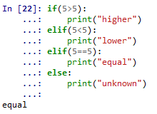
Review of Basics
Conditionals
if
if-else
if-elif
if-elif-else
switch
Not implemented, must use dictionaries in a function
Why did we do this?

Slide 15
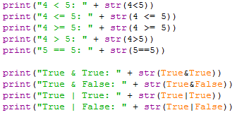
Review of Basics
Conditionals
Logical operators examples
Notes:
Data types must match for equality to return true

Slide 16
Review of Basics
Conditionals Class Exercise
Write code to compare a number with a string that contains a number. For instance, ’10’ > 5 should be True.

Slide 17
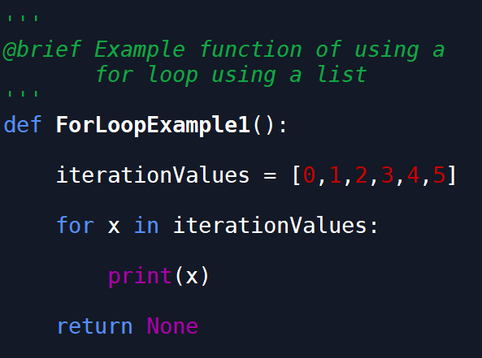
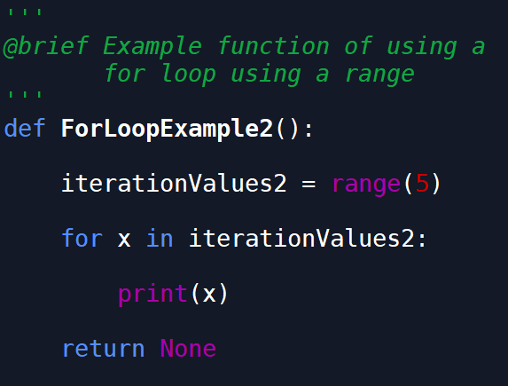
Review of Basics
Loops
for
Loops through each element in a collection
Use range() to get a quick list of elements

Slide 18
Review of Basics
Loops
while
See next slide

Slide 19
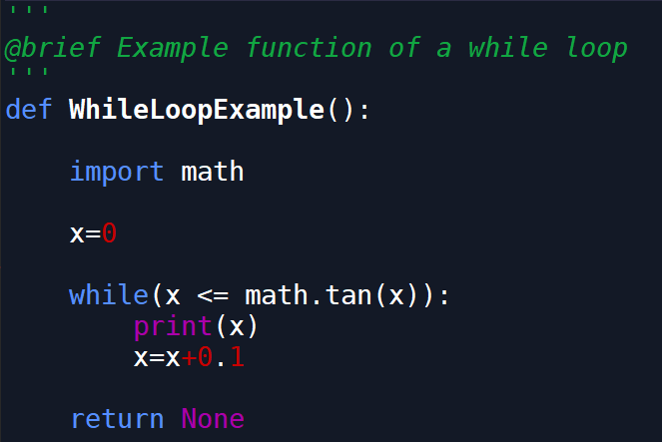
Review of Basics

Slide 20
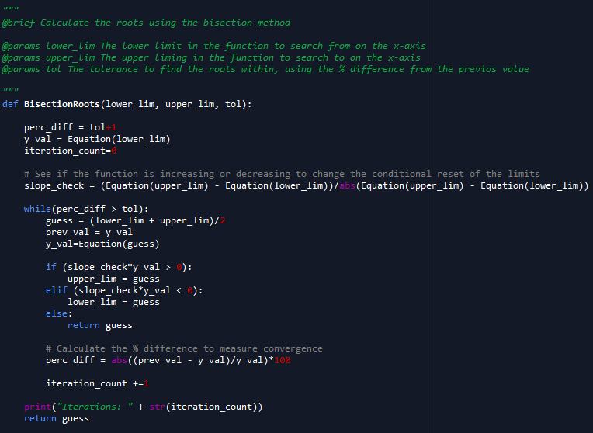
Review of Basics

Slide 21
Review of Basics
Functions
Defining the function:
def <function_name>(parameter_list):
<body of function>
return <optional_return_val>
Calling the function:
<function_name>(<argument_list>)

Slide 22
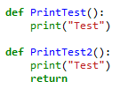
Review of Basics
Functions
Void Functions
Omit the “return” at the end
Include the “return”, but don’t put anything to return
Both methods do the same thing
Setting a variable equal to the functions produces the same type and value output

Slide 23
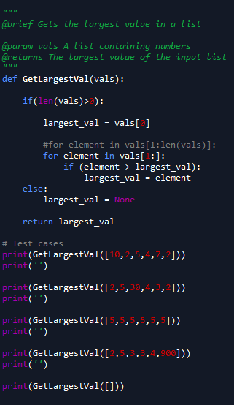
Review of Basics
Functions
Why did we do this?

Slide 24

Review of Basics
Functions

Slide 25
Review of Basics
Functions Class Exercises
Create a function that will return a number
Create a function with two inputs
Create a function with two string inputs, that returns the two strings combined together separated by a space.
I.e. func(“string_1”,”string_2”) == “string_1 string_2”

Slide 26
Review of Basics
Functions Class Exercises
Create a function with an input of a list of integers. The output is the same list, with each value squared. The function must contain a loop or a list comprehension.

Slide 27
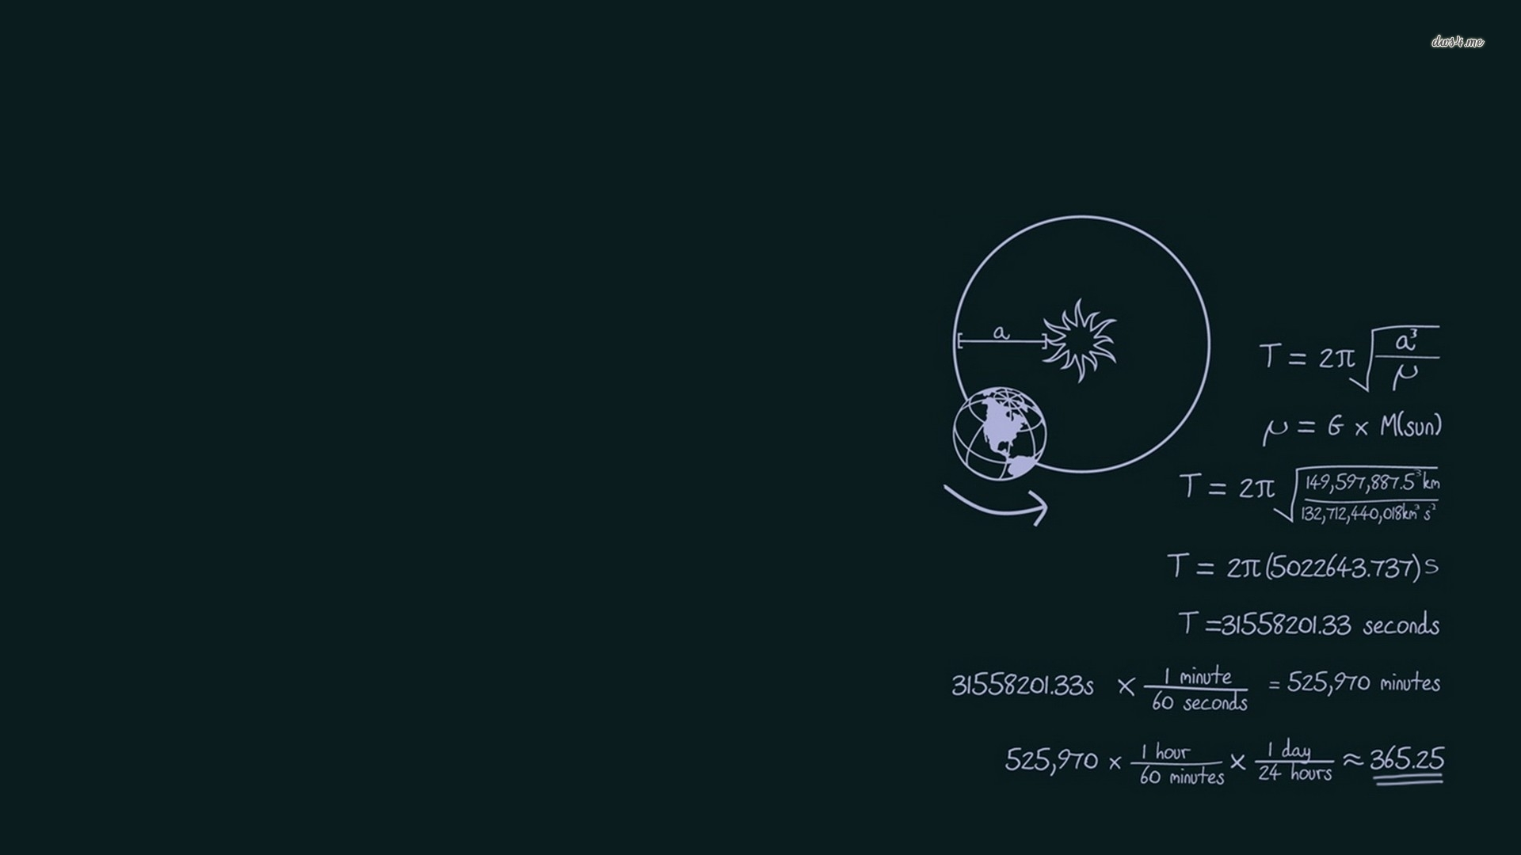
Mini Project
Given a list of part numbers to search and a list of part numbers to find, both in files, find how many

Slide 28
Extending Python
More Types
Furthering the Collective
Improved Logic and Error Handling
List Comprehensions
Lambda Expressions
Working with Files
Classes in Python
Keyword Arguments
GUI’s
Creating Executables

Slide 29

Extending Python
More types
Complex Numbers
complex(real,complex)
z=complex(3,4)
j as complex variable name
Z=3+4j = complex(3,4)
conjugate()
Complex conjugate
z.conjugate() = 3-4j

Slide 30
Extending Python
Furthering the Collective
# Methods and Properties of collections
List
Dictionaries
Sets
# Slice notation
a[start:end] # items start through end-1
a[start:] # items start through the rest of the array
a[:end] # items from the beginning through end-1
a[:] # a copy of the whole array

Slide 31
Extending Python
Furthering the Collective
Methods for lists, tuples, and dictionaries
min(x)
Get the element that has the minimum value in x
max(x)
Get element that has the maximum value in x
len(x)
Number of elements in x
Can also get the number of characters in a string

Slide 32
Extending Python
Furthering the Collective
Methods for lists
example_list.pop()
Remove and output the last element in the list
example_list.append(val)
Add val as a new element to the end of example_list
example_list.reverse()
Invert the relative location of each element in example list
See more in the docs
https://docs.python.org/3/library/stdtypes.html

Slide 33
Extending Python
Furthering the Collective
Slice notation to access elements
a[start:end] # items start through end-1
a[start:] # items start through the rest of the array
a[:end] # items from the beginning through end-1
a[:] # a copy of the whole array

Slide 34

Extending Python
Furthering the Collective
set
Set with {}
Creates distinct unordered pair
No indexing available
Removes any duplicates input into the set

Slide 35

Extending Python
Furthering the Collective
set
Can convert to list to use elements
Notice change in order from the first list once the set is converted back to a list

Slide 36
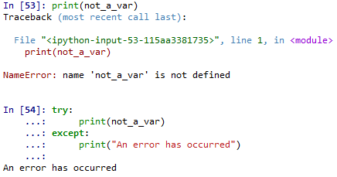
Extending Python
Improved Logic and Error Handling
Try-Except
Error handling

Slide 37
Extending Python
Improved Logic and Error Handling
Try-Except
Syntax
try:
<code statements to try>
except <error_type_1>:
<code when error type occurs>
except <error_type_2> as err:
<code when error type occurs, aliased as “Err”>
except:
<code that catches all other errors>

Slide 38

Extending Python
Improved Logic and Error Handling
Try-Except
Can catch all errors without specifying an exception

Slide 39

Extending Python
Improved Logic and Error Handling
Try-Except
Can catch specific types of errors by defining the exception

Slide 40
Extending Python
Improved Logic and Error Handling
Exception Types
https://docs.python.org/3/library/exceptions.html
NameError – Undefined variable

Slide 41
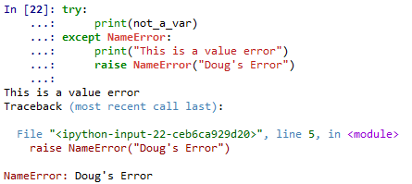
Extending Python
Improved Logic and Error Handling
Naming Errors
raise NameError(<error_name>)

Slide 42
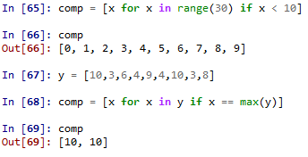
Extending Python
List Comprehensions
A better loop
Combine with conditionals

Slide 43

Extending Python
List Comprehensions
Example – Get specific values in a dictionary

Slide 44
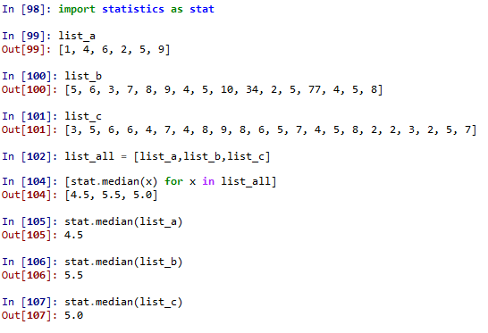
Extending Python
List Comprehensions
Example – get median of a list of lists

Slide 45

Extending Python
List Comprehensions
Nested list comprehensions
Example – get even numbers between 10 and 30

Slide 46
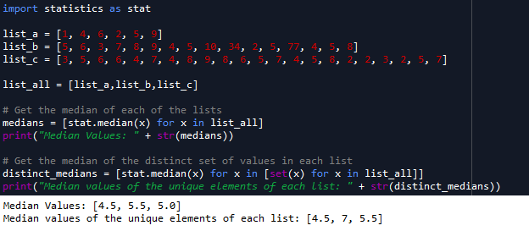
Extending Python
List Comprehensions
Can nest list comprehensions
Example – get medians of sets of values, and medians of the unique set of the same values

Slide 47
Extending Python
Lambda Expressions
Anonymous functions
a.k.a inline function
Very useful in Pandas

Slide 48

Extending Python
Lambda Expressions
lambda <dummy_var>: <statement using dummy var>

Slide 49
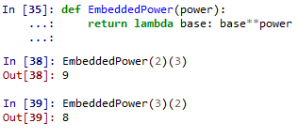
Extending Python
Lambda Expressions
Embedded function

Slide 50
Extending Python
Working with Files
open()

Slide 51

Quiz
Define:
List Comprehensions
Sets
Slice notation
Lambda expressions
List some error handling constructs in Python

Slide 52
Quiz
Objects
Quick definition
What 3 basic items define an object
Are classes needed to program?
Are classes needed to program well?
What are some things classes good for

Slide 53
Quiz Answers
List Comprehensions
Combination of a for loop and possible conditional statements in one statement
Sets
Unique, unordered set of values
Convertible to list if order/editing is needed

Slide 54
Quiz Answers
Slice notation
Allows quick access to sections of collections
Lambda expressions
In-line, anonymous functions aliasable to a variable name
Usable in standard functions
Requires additional argument list

Slide 55
Quiz Answers
List some error handling constructs in Python
Try-Except Statement
Allows attempted code execution
Code in try section will run
If failure occurs, execution immediately breaks to Except section

Slide 56
Quiz Answers
List some error handling constructs in Python
Exceptions
Can create an Except section for each type of exception
Raise
Raises an exception with a custom name

Slide 57
Quiz
Objects
Quick definition
Organizational construct that contains related properties, methods, and hierarchy/inheritance
Ability to control access and reuse (access modifiers)
Allows the creation of user-defined datatypes
Reference types are created from classes
What 3 basic items define an object
Identity
State
Behavior

Slide 58
Quiz
Objects
Are classes needed to program?
No
Are classes needed to program well?
No

Slide 59
Quiz
Objects
What are some things classes good for
Organization
Access control
Code reuse
Breaking up code into easily testable, easily understandable sections
Easy maintenance

Slide 60
Extending Python
Classes in Python
Quick Review of Classes
Note: This quick review is the general case of classes. Python has some idiosyncrasies that will be discussed later

Slide 61
Extending Python
Classes in Python
Quick Review of Classes
ID – Constructor, variable name, memory location(s)
State – Properties/Fields
Behavior - Methods

Slide 62
Extending Python
Classes in Python
Quick Review of Classes
Static – One class only
Example – ‘random’ class in Python
Dynamic/Instance – Objects created for each instance
Any primitive variable (string, int, etc)
Dictionaries
Lists

Slide 63
Extending Python
Classes in Python
Quick Review of Classes
Access
Can set members’ access levels
public
private
protected
internal
Note: This is not enforced in Python—all members are public

Slide 64
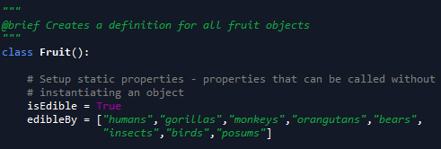

Extending Python
Classes in Python
Static Properties
Callable without creating an object from the class
Defined before the constructor
Similar to how properties defined in C#

Slide 65
Extending Python
Classes in Python
Object Properties
Defined anywhere in a function/constructor
Use the “self” keyword to differentiate from static properties

Slide 66
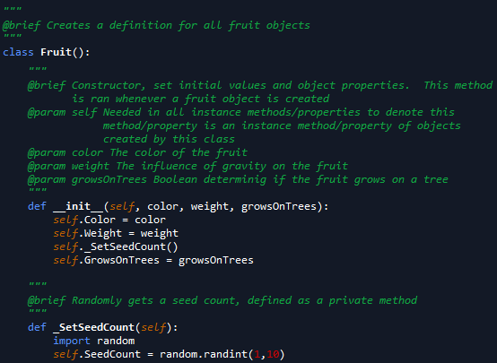

Extending Python
Classes in Python
Object Properties

Slide 67
Extending Python
Classes in Python
Object Properties
Notice scope difference in previous example
“self” keyword indicates object property
Not a local variable of _SetSeedCount(self)
Attempting to access SeedCount without “self” gives error
Why is this?

Slide 68
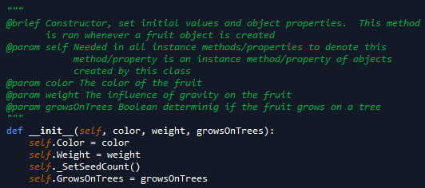
Extending Python
Classes in Python
Constructor
Initialization method
Always has “self” as a parameter
Always “def __init__(self,<list_of_parameters>)”

Slide 69
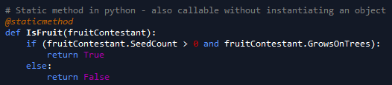

Extending Python
Classes in Python
Methods
All functions other than constructor in the class
Static methods have decorator precursor @staticmethod

Slide 70
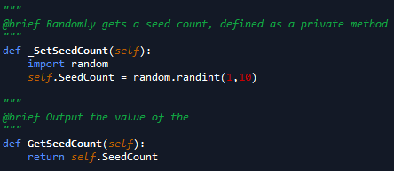

Extending Python
Classes in Python
Methods
Instance methods defined as a normal function
Always has “self” as a parameter

Slide 71
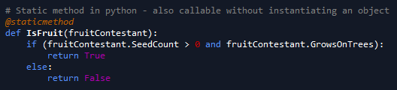
Extending Python
Classes in Python
Methods
Static Method Example

Slide 72
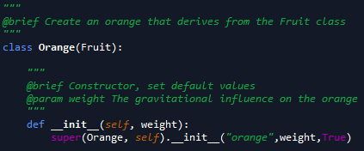
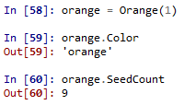
Extending Python
Classes in Python
Inheritance
Ability for one class to use properties and methods of its parent class

Slide 73
Extending Python
Classes in Python
Inheritance
super() used to call parent methods/get parent properties in the child object

Slide 74
Extending Python
Classes in Python
Access Control in Python
Honor system
Private fields, properties, and methods start with an underscore
“_internal_var”
“def _internal_method():”

Slide 75
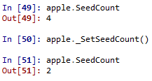
Extending Python
Classes in Python
Access Control in Python
Notice lack of prevention of using “private” methods

Slide 76
Extending Python
Classes in Python
Abstract Classes
Cannot create types from this class
A class intended only to be inherited from
Will go over more in C# due to ease of understanding code

Slide 77
Extending Python
Classes in Python
Example Day
Code Design
Unified Modeling Language (UML)
Block diagrams of members of classes
Methods
Properties
Fields

Slide 78
Extending Python
Classes in Python
Examples Premade
Helper class
Helper Class for Math
Examples Created In Class
Animal → Mammal → Cat
Food → Meat → Steak

Slide 79
Extending Python
Positional and Keyword Arguments
Defines order of how arguments are passed to functions/methods
Just like passing values in command line languages like PowerShell and bash

Slide 80
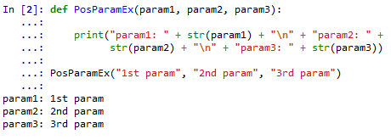
Extending Python
Positional and Keyword Arguments
Positional Argument
Arguments passed in the order of the parameters
If order is not maintained, errors will occur

Slide 81
Extending Python
Positional and Keyword Arguments
Keyword Arguments
Argument preceded by an identifier
Must be used with default parameters
Order does not need to match parameter order

Slide 82
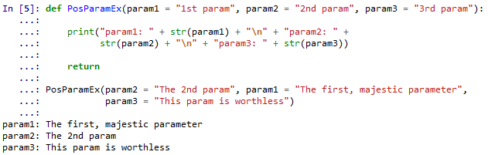
Extending Python
Positional and Keyword Arguments
Keyword Arguments
Notice the argument order of the function call

Slide 83
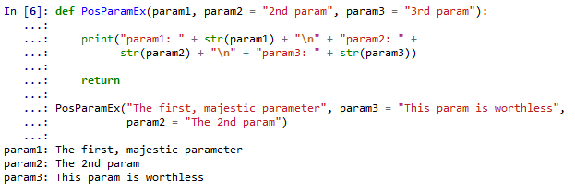
Extending Python
Positional and Keyword Arguments
Can combine both
Positional parameters must occur first

Slide 84
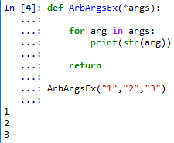
Extending Python
Arbitrary Argument Lists
List of arguments without formal parameters in methods/functions
Denoted by parameter “*<param_name>”
Typically denoted by “*args”
Can use any name, such as “*list_of_stuff”

Slide 85
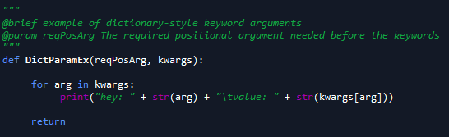

Extending Python
Keyword Dictionaries
Similar to arbitrary arguments, but parameters are a dictionary
Uses syntax “**<dict_name>”
Typically, named “**kwargs” or “**keywords”

Slide 86
Extending Python
GUI’s
PyQt
Popular C++ GUI ported to Python
TKInter
Gnome
Based on Gnome Linux desktop environment
PyGTK
Based on GTK Linux desktop environment
IronPython
Based on MS .NET platform
Can import DLL’s from other languages
WxPython
We will focus on PyQt

Slide 87
Extending Python
GUI’s
Terminology
Window
A graphical interface with controls
Widgets (a.k.a Controls in C#)
Inputs and outputs
Text box
Input Box
Button

Slide 88
Extending Python
GUI’s
Basics of Program
Class that inherits from base window class
Initialization from base class
Use of show() method on class to make window appear
Create QApplication app
Instantiate object of Window
Exit code execution using app.exec_() or app.exe() (Python version >= 3.x)
See BasicWindow.py for basic example

Slide 89
Extending Python
GUI’s
Basics of Program
Necessary Imports
PyQt5.QtWidgets.QWidget
PyQt5.QtWidgets.QApplication

Slide 90
Extending Python
GUI’s
Basics of Program
QWidget
Base class to inherit Window classes from
QApplication()
Manages GUI application control flow and settings
Initializes necessary objects behind the scenes
There can be only 1 per GUI application
Can have as many windows as possible
Must pass sys.argv, still determining why

Slide 91
Extending Python
GUI’s
Initial Curiosities/Gotchas
The system will return ‘-1’ after a successful run
After each successful run, the kernel must be restarted

Slide 92
Extending Python
GUI’s
Window
Inherit from base QT window ‘Qwidget’
Defaults

Slide 93
Extending Python
GUI’s
Window Properties
Size
Defaults to center of screen at a default size
Can change with ‘self.setGeometry(<left>, <top>, <width>, <height>)’ method
Title
Default title is ‘pythonw’
Can change with ‘self.setWindowTitle(<title>)’ property

Slide 94
Extending Python
GUI’s
Window Text
Two types:
QLabel
Textbox

Slide 95
Extending Python
GUI’s
Window Text using QLabel
Can show text via text and QLabel
Create QLabel
Set text
Format using setStyleSheet
See TextWindow.py for example

Slide 96
Extending Python
GUI’s
Window Text using QLabel
Necessary Imports
PyQt5.QtWidgets.QLabel

Slide 97
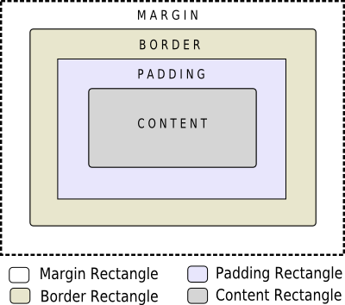
Extending Python
GUI’s
Window Text using QLabel
Styling
Box Model, like web languages

Slide 98
Extending Python
GUI’s
Window Text using QLabel
Styling
<QLabel_Var>.move(left, top)
Move the location of the text to the (left, top) position
The left coordinate is measured from the left side, to the right
The top coordinate is measured from the top towards the bottom
<QLabel_Var>.setStyleSheet(<style_string>)
Sets the style in a CSS-like layout

Slide 99
Extending Python
GUI’s
Window Text using QLabel
Example code TextWindowQLabel.py

Slide 100
Extending Python
GUI’s
Window Text using Textboxes
QLineEdit in PyQt
Create QLineEdit object
Set the text using the “setText()” method
Show the QLineEdit object

Slide 101
Extending Python
GUI’s
Window Text using Textboxes
Necessary Imports:
PyQt5.QWidgets.QLineEdit

Slide 102
Extending Python
GUI’s
Window Text using Textboxes
Example code TextWindowQLineEdit.py

Slide 103
Extending Python
GUI’s
Quick note on documentation
Don’t forget to check parent docs for all functions
Example: QLineEdit.move
Function does not exist on QLineEdit page
http://doc.qt.io/qt-5/qlineedit.html
Exists on QWidget page, the parent of QLineEdit
http://doc.qt.io/qt-5/qwidget.html#move-1
TLDR: Check chain of inheritance for missing members

Slide 104
Extending Python
GUI’s
How do I know the chain of inheritance?
Check Docs
Can tell from imports
Example:
QLabel and QLineEdit are children of PyQt5.QWidgets

Slide 105
Extending Python
GUI’s
Window Images
Can show images via pixel maps
Create QLabel
Create QPixmap of image
Set the Pixmap property of the QLabel
See ImageWindow.py for example

Slide 106
Extending Python
GUI’s
Window Images
Necessary Imports:
PyQt5.QtWidgets.QLabel
PyQt5.QtGui.QIcon
PyQt5.QtGui.QPixmap

Slide 107
Extending Python
GUI’s
Window Images
QLabel
Class provider for images or text:
Plain text
Rich text
Pixmap
Movie
Number
Nothing
Cannot be used for direct interaction

Slide 108
Extending Python
GUI’s
Window Images
QPixmap
Used to show images on screen
Other objects used for pixel manipulation and other functionality
See https://doc.qt.io/qt-5/qpixmap.html for more

Slide 109
Extending Python
GUI’s
Button
Necessary Imports
PyQt5.QtWidgets.QPushButton
PyQt5.QtWidgets.QVBoxLayout

Slide 110
Extending Python
GUI’s
Button
Create the button
self.button = QPushButton(<button_text>, self)
Create optional items
Tool tip: self.button.setToolTip(<tool_tip_text>)
Create event handler for button click
Can be any method
Link event handler (a.k.a. slot) to the connect signal
self.button.clicked.connect(self.<method_name>)

Slide 111
Extending Python
GUI’s
Button
Fix layout automatically with QBoxLayout
Default position is top left
QVLayout will auto-align button object(s) vertically
layout = QVBoxLayout(self)
layout.addWidget(self.<button_ojbect>)

Slide 112
Extending Python
GUI’s
Signals and Slots
Signal calls a method (acts as event caller)
Use like an object: sig = pyqtSignal()
Wire to an action and emit:
self.sig.connect(self.<method>)
Self.sig.emit()
Slot handles the signal (acts as event action)
Define slot method with @pyqtSlot() decorator
@pyqtSlot()
def slot():
Do_stuff
For our code, the signal and slot are automatically created and don’t need specifically created
See http://pyqt.sourceforge.net/Docs/PyQt5/signals_slots.html for more

Slide 113
Extending Python
GUI’s
Other Widgets
QCheckBox
Check box
QSlider
Slide bar with handle
QProgressBar
Bar that fills in to show progress
QCalendarWidget
Monthly calendar

Slide 114
Extending Python
GUI’s
Other Widgets
QLineEdit
Box that allows the entering and editing of text
Copy and paste operations allowed
QSplitter
GUI control of child widgets
QComboBox
Menu that drops down, with options a user can select

Slide 115
Extending Python
GUI’s
Further Learning
http://zetcode.com/gui/pyqt5/
https://pythonspot.com/pyqt5/
API References
http://pyqt.sourceforge.net/Docs/PyQt5/
http://doc.qt.io/qt-5/index.html

Slide 116
Extending Python
GUI’s
In-Class Project – War Card Game
UML Class Layout
Design Layout
Paint
Graphic Design Software
Code Design

Slide 117
Extending Python
GUI’s – War Card Game
Code Review
QLabel
QPixmap Image
Text
QPushButton
Button
QLineEdit
Input box for text
QComboBox
Dropdown list of selectable items

Slide 118
Extending Python
Creating Executables

Slide 119
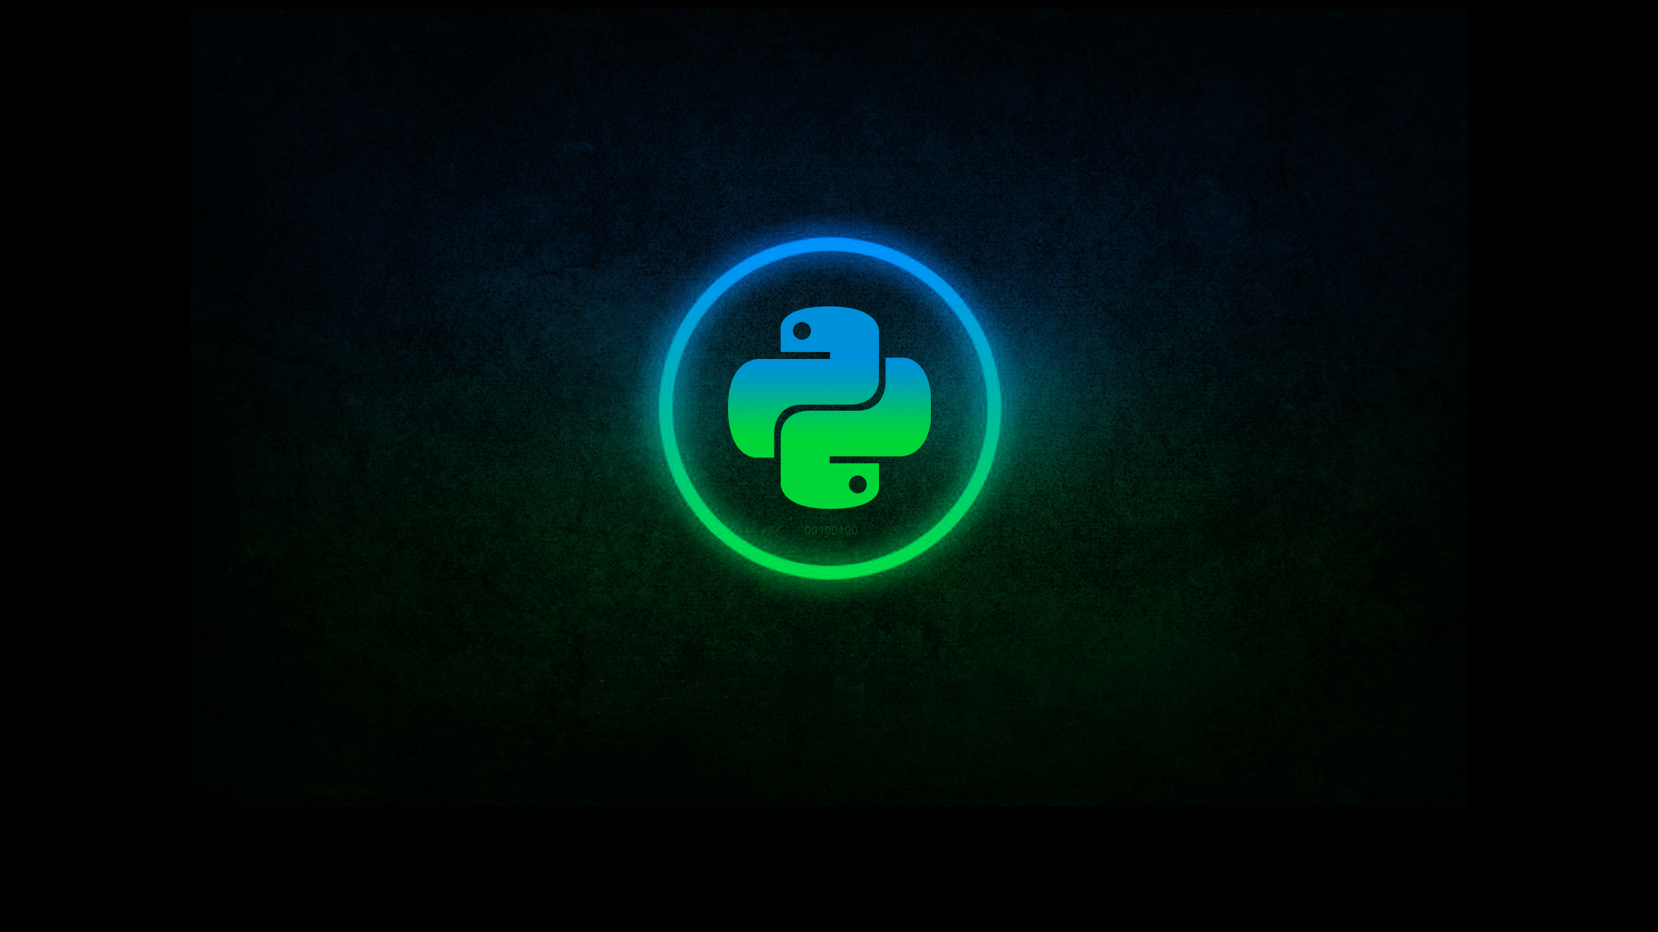
The Pythonic Way
Readability
Tabs vs {}
Explicit Code vs Implicit
*args/**kwargs vs list of each parameter
Built-in mechanism for documentation “”” “””
List Comprehensions
Setting Up Loops
Mathematical Basis

Slide 120
Pandas Data Wrangling
Overview
Series
DataFrames
Grouping
Indexing
Merges
Joins

Slide 121
PyODBC
Overview

Slide 122

PyODBC
PyODBC Data Base Connector

Slide 123
MatPlotLib Visuals
Overview

Slide 124
Scikit-Learn Machine Learning
Overview
Basic Linear Model
Algorithm Types
Tuning

Slide 125
LICENSE
Copyright 2018 Douglas Bowman
Permission is hereby granted, free of charge, to any person obtaining a copy of this software and associated documentation files (the "Software"), to deal in the Software without restriction, including without limitation the rights to use, copy, modify, merge, publish, distribute, sublicense, and/or sell copies of the Software, and to permit persons to whom the Software is furnished to do so, subject to the following conditions:
The above copyright notice and this permission notice shall be included in all copies or substantial portions of the Software.
THE SOFTWARE IS PROVIDED "AS IS", WITHOUT WARRANTY OF ANY KIND, EXPRESS OR IMPLIED, INCLUDING BUT NOT LIMITED TO THE WARRANTIES OF MERCHANTABILITY, FITNESS FOR A PARTICULAR PURPOSE AND NONINFRINGEMENT. IN NO EVENT SHALL THE AUTHORS OR COPYRIGHT HOLDERS BE LIABLE FOR ANY CLAIM, DAMAGES OR OTHER LIABILITY, WHETHER IN AN ACTION OF CONTRACT, TORT OR OTHERWISE, ARISING FROM, OUT OF OR IN CONNECTION WITH THE SOFTWARE OR THE USE OR OTHER DEALINGS IN THE SOFTWARE.

